Slide 1

School of CS & AI, SR University
Course Code | Course Title | L | R | P | Cr
24CS301ES205 | CYBER SECURITY | 3 | 0 | 2 | 4
Program Core
Lab Experiments
Web Reconnaissance Password Security Cryptography Implementation Network Vulnerability Assessment Packet Analysis Firewall and IDS Web Application Security Wireless Security Malware Analysis Digital Forensics Incident Response Cloud Security
Lab- 1 (week 1)
Website Reconnaissance and OSINT
Lab1: Reconnaissance on a target website using tools like Nmap, Whois, and Google Dorks to gather open-source intelligence
Course Faculties
Dr. Vivek Kumar Dhimole Dr. K Rajchandar Dr. Shanker Chandre Ms. Faiza Iram Dr. Santosh Kumar Henge Dr. T Bharath Kumar Dr. Sudarshan Behara | Jacky Patel Aslaan Khan Uday Kiran Bade Kundan Kumar Md Faizan

Slide 2
Lab Objectives
The objectives of this lab are to:
Understand the concept of reconnaissance and OSINT
Perform website reconnaissance using ethical tools
Identify open ports, services, and domain details
Analyze publicly available information responsibly
Document findings in a structured manner

Slide 3
Lab Outcomes
After completing this lab, students will be able to:
Explain reconnaissance and OSINT concepts
Use Nmap for basic website scanning
Perform Whois lookups for domain information
Use Google Dorks to gather public intelligence
Identify potential attack surfaces ethically

Slide 4
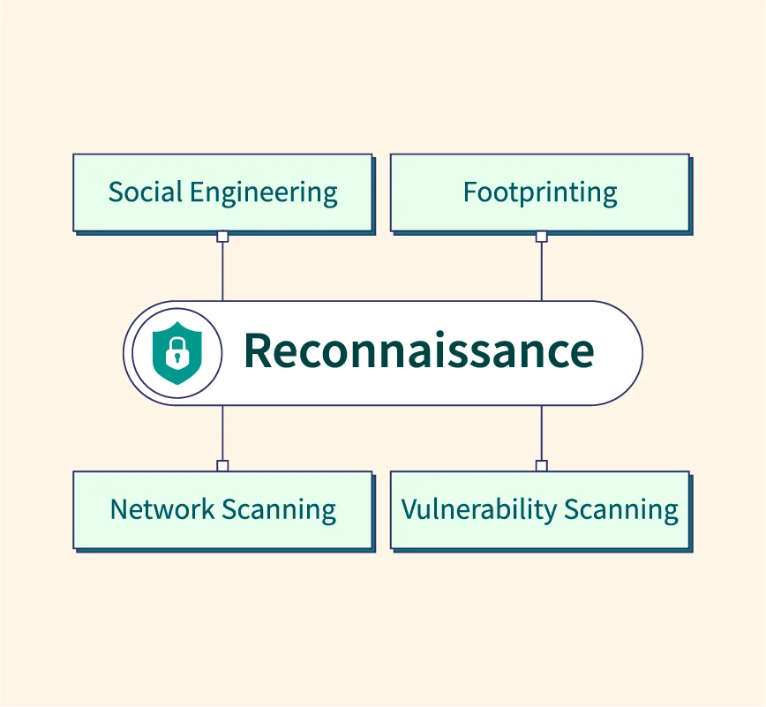
What is Reconnaissance?
Reconnaissance is the first phase of cyber security assessment where information about a target system or website is collected without actively exploiting it.
It focuses on information gathering
  Uses publicly available data (Open-Source Intelligence – OSINT)
  Helps understand the attack surface of a website
Key idea:
“Know the target before securing or attacking it.”

Slide 5
Why Reconnaissance is Used
Reconnaissance is used to:
Identify exposed services and technologies
Discover domain and server details
Understand possible entry points for attacks
Support security audits and penetration testing
Improve defensive security planning
Without reconnaissance, security assessments are incomplete.

Slide 6
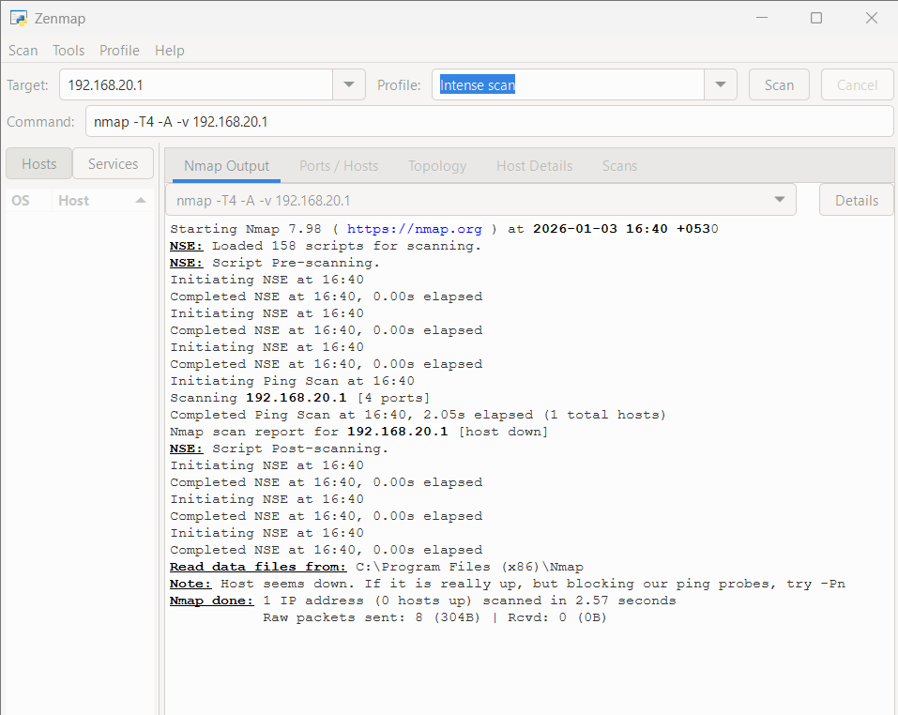
Where Reconnaissance is Used
Reconnaissance is widely used in:
Penetration testing
Vulnerability assessment
Red team and blue team exercises
Bug bounty programs
Incident investigation
Cyber forensics and audits

Slide 7
Tools Used
Nmap – Network scanning and service discovery
Whois – Domain registration and ownership lookup
Google Dorks – Advanced search queries for OSINT
Web Browser – For searches and verification

Slide 8
Ethical Guidelines (Important)
Perform reconnaissance only on permitted targets
Use:
  localhost
  Lab servers
  Instructor-approved websites
Do not exploit or damage systems
Follow ethical hacking principles

Slide 9
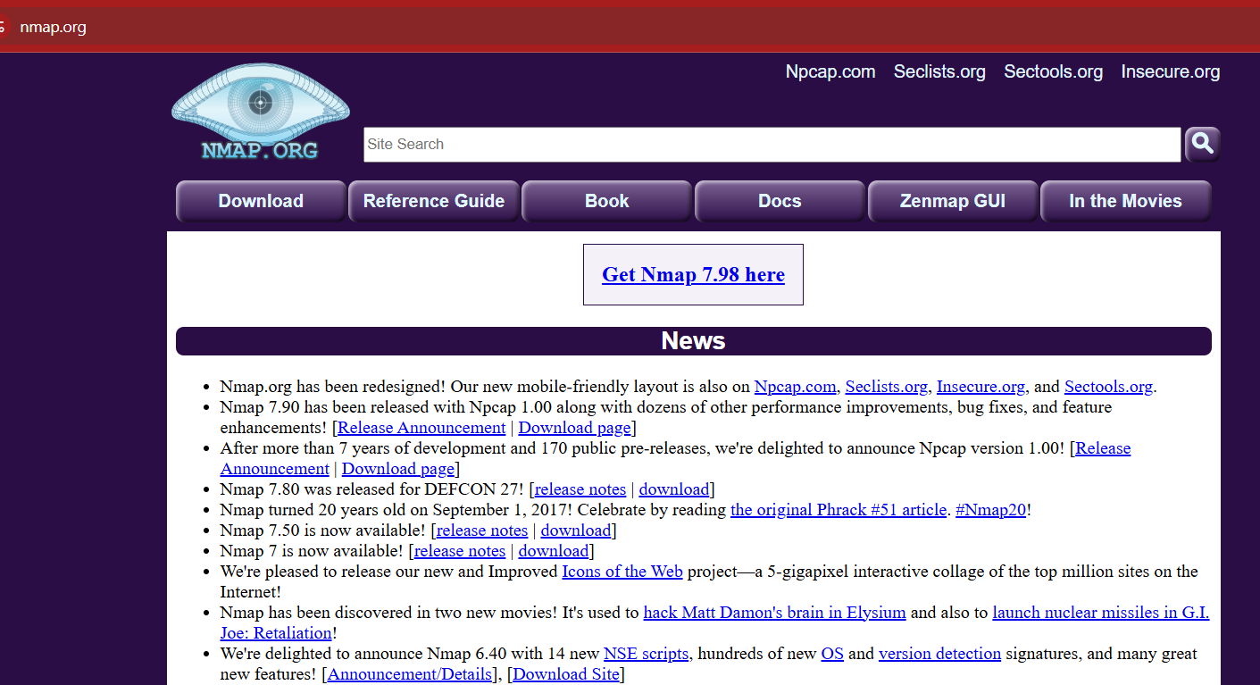
Step 1 – Install “nmap”
Choose a target website:
Example:
  example.com
  scanme.nmap.org
  Instructor-approved site
Record:
Website URL
IP address (if known)

Slide 10
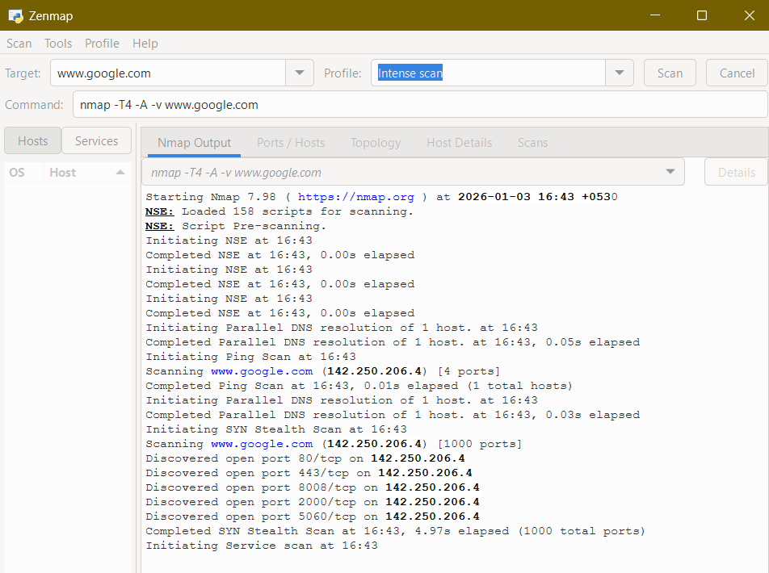
Step 2 – Reconnaissance using Nmap
  Use Nmap to identify open ports and services.
Command:
  nmap -A target_website
What Nmap provides:
  Open ports
  Running services
  Service versions
  OS information (if detectable)

Slide 11
Open Ports Found
Discovered open port 80/tcp
Discovered open port 443/tcp
Discovered open port 8080/tcp
Discovered open port 2000/tcp
Discovered open port 5060/tcp
Open ports are not vulnerabilities;
unnecessary open ports are.
Port | Meaning | Why Open
80 | HTTP | Website access
443 | HTTPS | Secure web traffic
8080 | Alternate HTTP | Load balancing / proxy
2000 | Custom service | Internal Google service
5060 | SIP | Communication service

Slide 12
Why Google has many open ports (critical concept)
Google is a global infrastructure
Uses:
  Load balancers
  Proxies
  Distributed services
Open ports are intentional and controlled
👉 “Seeing open ports on Google does NOT mean Google is insecure.”

Slide 13
What NOT to do (VERY IMPORTANT FOR ETHICS)
❌ Do not try vulnerabilities
❌ Do not brute force
❌ Do not exploit services
👉 This lab is reconnaissance only.

Slide 14
Step 3 – Analyze Nmap Results
From Nmap output, identify:
  Open ports (e.g., 80, 443)
  Services (HTTP, HTTPS, SSH, etc.)
  Service versions
  Possible exposure points
Prepare a simple table:
Port | Protocol | Service | State

Slide 15
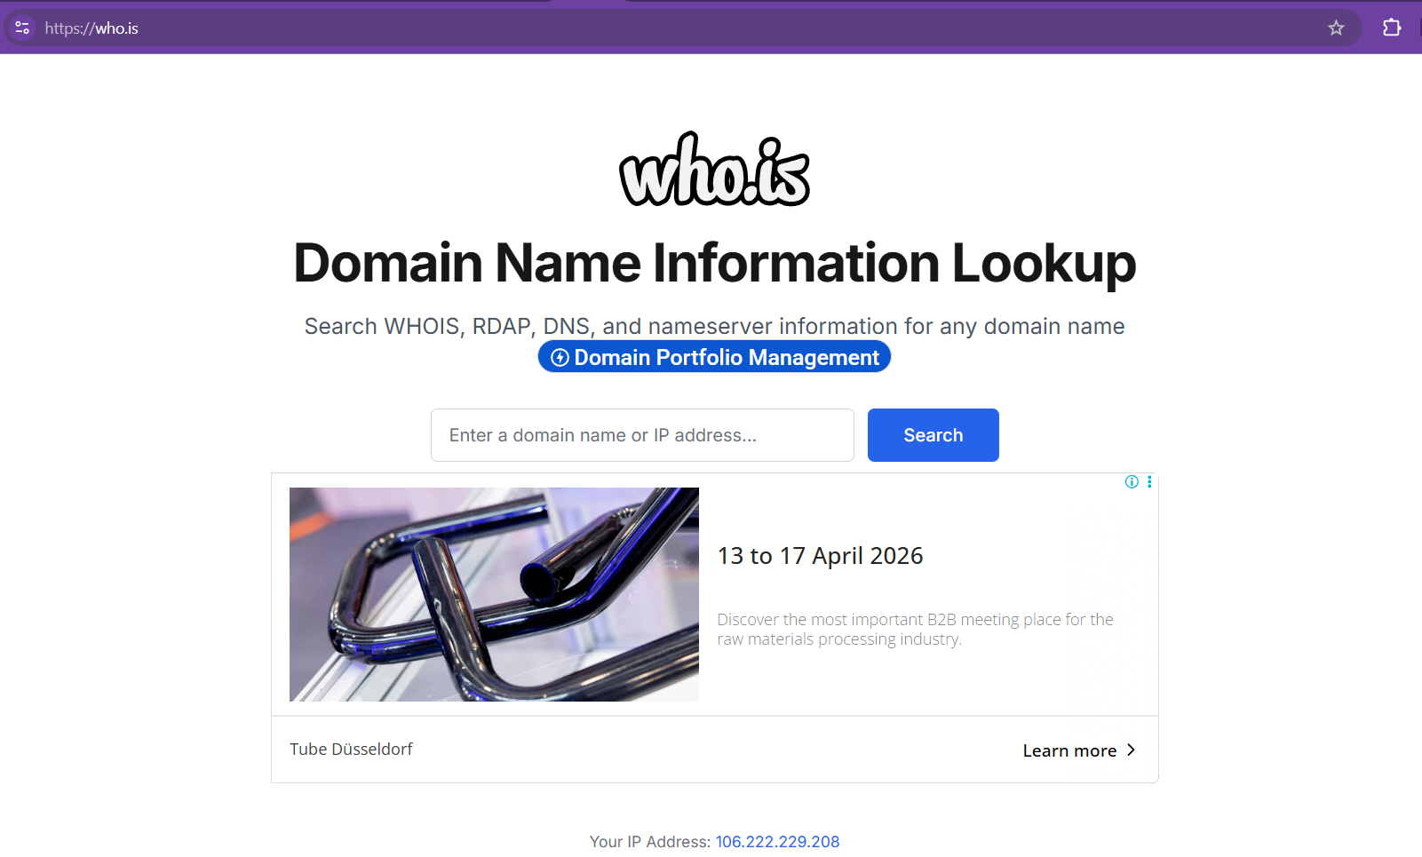
Step 4 – Whois Lookup
Perform Whois lookup to gather domain information.
Command:
  whois target_website
Information obtained:
  Domain registrar
  Registration date
  Expiry date
  Name servers
  Organization details (if public)

Slide 16
WHOIS output
Field | Description
Domain Name | Which website
Registrar | Who registered it
Creation Date | How old the domain is
Expiry Date | Validity
Name Servers | DNS infrastructure

Slide 17
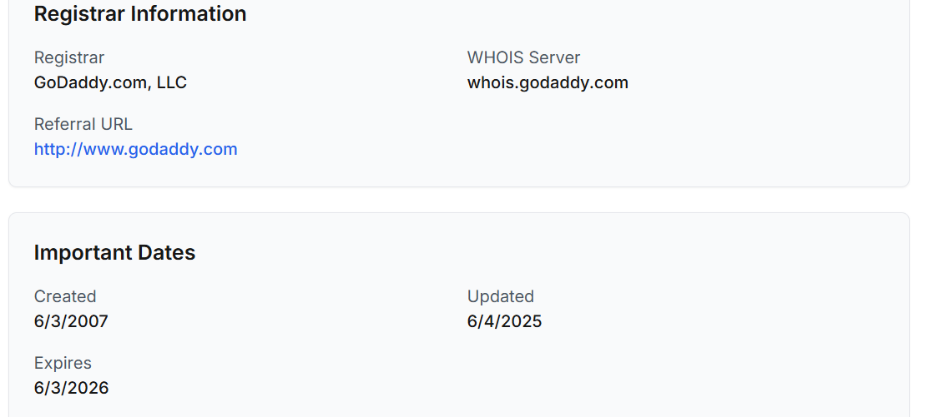
Try: Whois-> www.flipkart.com

Slide 18
Step 5 – Google Dorks for OSINT
Google Dorks for OSINT
Use Google advanced search queries to find exposed information.
Examples:
  site:target_website
  site:target_website filetype:pdf
  site:target_website intitle:index.of
Google Dorks can reveal:
  Public documents
  Directory listings
  Exposed configuration files
  Login pages

Slide 19
What is Google Dork?
Google Dorking means using advanced Google search operators to find sensitive or hidden information that is publicly available on the internet.
Important to stress:
  Google Dorks do not hack
  They only search what is already public
  The power comes from smart searching
👉 “Google Dorks is like asking Google very specific questions.”

Slide 20
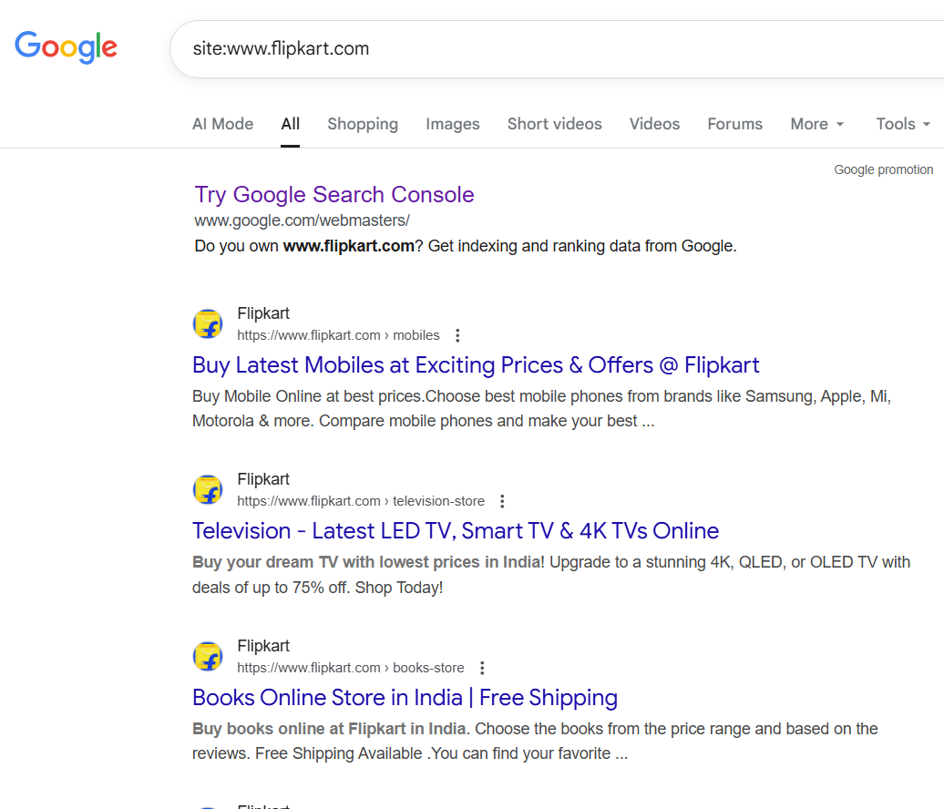
Site:www.flipkart.com
Shows all indexed pages of the given website

Slide 21
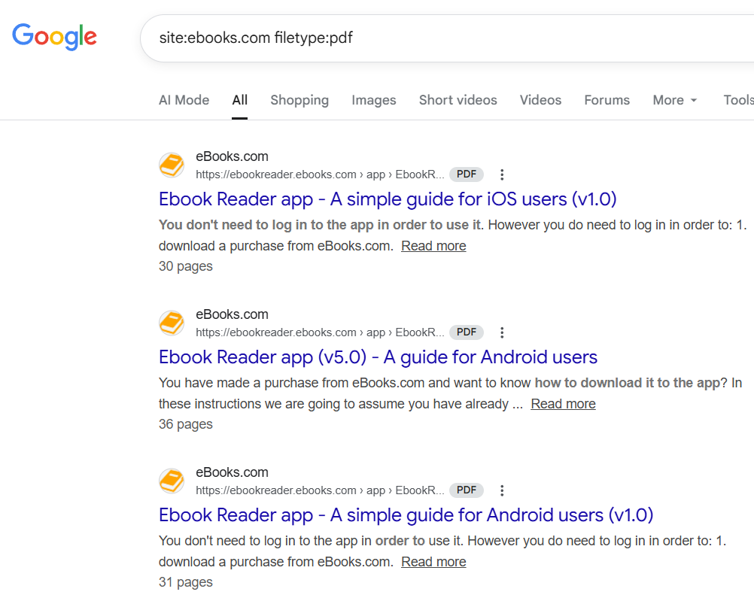
Site:www.flipkart.com filetype:pdf
Shows all indexed pdf of the given website

Slide 22
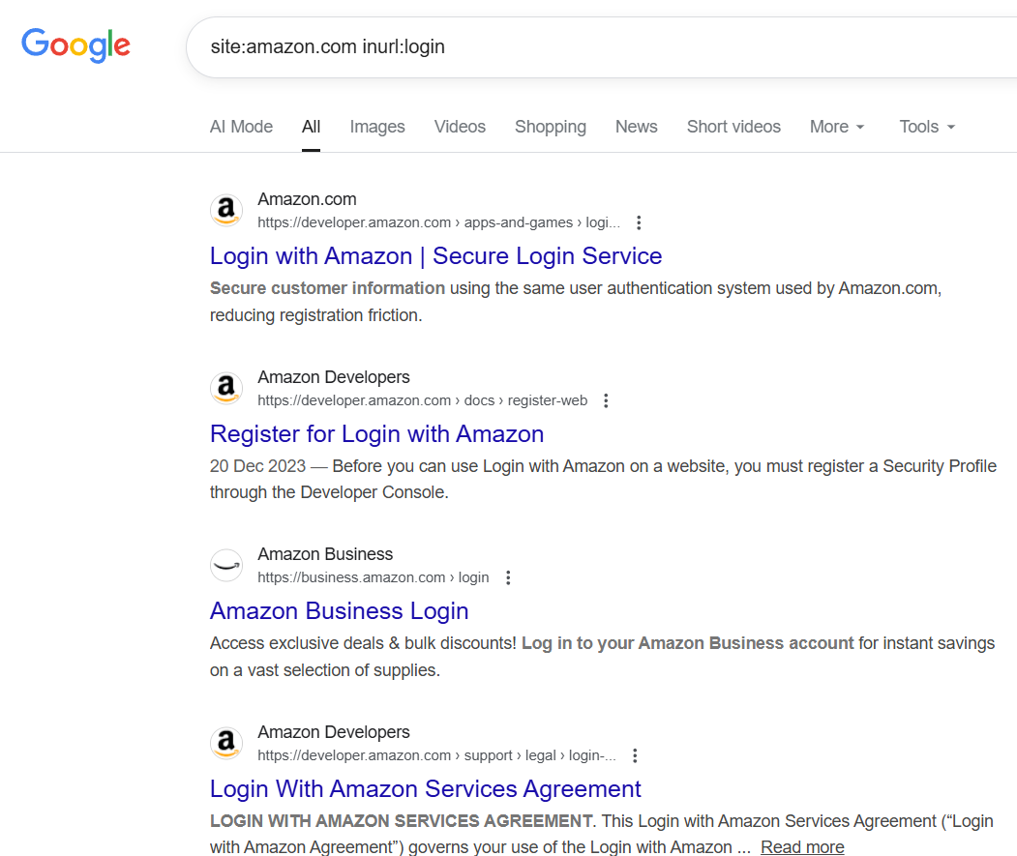
Site:www.amazon.com inurl:login
Shows all indexed login page of the given website

Slide 23
Examples
S. No | Google Dork Query | What It Searches For | Cyber Security Use
1 | site:example.com | All pages indexed by Google for the website | Understand overall website exposure
2 | site:example.com filetype:pdf | Public PDF files on the website | Identify leaked documents or reports
3 | site:example.com filetype:docx | Word documents | Check for exposed internal documents
4 | site:example.com filetype:xls | Excel files | Detect financial or user data exposure
5 | site:example.com inurl:login | Login pages or portals | Identify authentication entry points
6 | site:example.com intitle:"login" | Pages with “login” in the title | Locate user/admin login pages
7 | site:example.com intitle:"index of" | Open directory listings | Detect server misconfiguration
8 | site:example.com filetype:bak | Backup files | Find accidentally exposed backups
9 | site:example.com filetype:sql | Database dump files | Check for database exposure
10 | site:example.com filetype:conf | Configuration files | Identify leaked configuration details

Slide 24
Examples
S. No | Google Dork Query | What It Searches For | Cyber Security Use
11 | site:example.com inurl:admin | Admin pages | Detect exposed admin interfaces
12 | site:example.com inurl:config | Configuration-related URLs | Identify misconfigured services
13 | site:example.com filetype:log | Log files | Detect exposed system or access logs
14 | site:example.com inurl:backup | Backup directories | Check for public backup folders
15 | site:example.com filetype:txt | Text files | Identify notes or sensitive data leaks
16 | site:example.com intitle:"error" | Error pages | Reveal application misconfigurations
17 | site:example.com inurl:test | Test or development pages | Detect leftover test environments
18 | site:example.com filetype:env | Environment configuration files | Detect exposed API keys or secrets
19 | site:example.com "password" | Pages containing the word “password” | Identify poor security practices
20 | site:example.com inurl:uploads | Upload directories | Check exposure of uploaded files

Slide 25
Why Google Dorks are used in Reconnaissance
Websites often expose:
  PDF files
  Login pages
  Backup files
  Configuration files
Normal Google search may not show them
Google Dorks help attackers discover hidden exposure
Defenders use it to fix leaks before attackers find them
👉 “If Google can find it, attackers can find it.”

Slide 26
How Google Dorks work (core idea)
Google provides search operators like:
  site: → search within a website
  filetype: → search specific file types
  intitle: → search page titles
  inurl: → search URLs
Google Dorks combine these operators.

Slide 27
Steps
Step-by-Step: How to use Google Dorks
Step 1: Open Google
Just use a normal browser.
Step 2: Use basic site search
site:example.com
Step 3: Find public documents
site:example.com filetype:pdf

Slide 28
Steps
Step 4: Look for login pages
site:example.com inurl:login
👉 Finds login portals.
Step 5: Check directory listing
site:example.com intitle:"index of"
👉 Finds open directories (misconfiguration).

Slide 29
Steps
What kind of information Google Dorks can reveal
Teach students to observe:
Public reports
User manuals
Employee documents
Backup files
Admin panels (login pages)
⚠️ Important:
“Finding is allowed. Exploiting is NOT allowed.”

Slide 30
Ethical warning (VERY IMPORTANT)
❌ Do not access private data
❌ Do not bypass authentication
❌ Do not download confidential files
👉 Google Dorks is for awareness, not misuse.
“Nmap shows what the server exposes, WHOIS shows who owns it, and Google Dorks shows what the world can already see.”

Slide 31
Step 6 – Identify Attack Surface
Based on findings, analyze:
Exposed services
Publicly accessible files
Technology stack clues
Possible misconfigurations
Note:
This is analysis only, not exploitation.

Slide 32
Observations and Documentation
Students should document:
Nmap scan results
Whois information
Google Dorks findings
Screenshots of commands and outputs
Observations on exposure

Slide 33
Sample Observation
Website runs HTTP and HTTPS
Uses Apache web server
Domain registered recently
Public PDF files accessible
No critical exposure observed

Slide 34
Lab Summary
Reconnaissance is the foundation of cyber security assessment
OSINT helps gather valuable public information
Nmap identifies technical exposure
Whois provides domain-level intelligence
Google Dorks reveal hidden public data
Ethical use of reconnaissance strengthens security posture

Slide 35
Conclusion
This lab demonstrated how reconnaissance and OSINT techniques help understand a website’s exposure without performing attacks. These skills are essential for both attackers and defenders to improve cyber security.

